Slide 1


Slide 2

EASTER EGG

Slide 3

EASTER BASKET

Slide 4

CATKINS

Slide 5
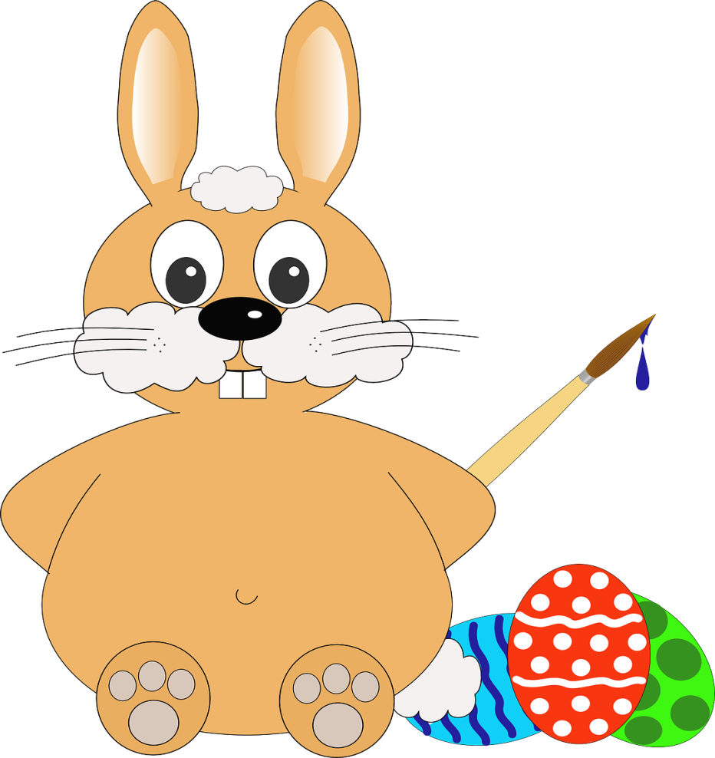
BUNNY

Slide 6

CHICK

Slide 7

DAFFODIL

Slide 8
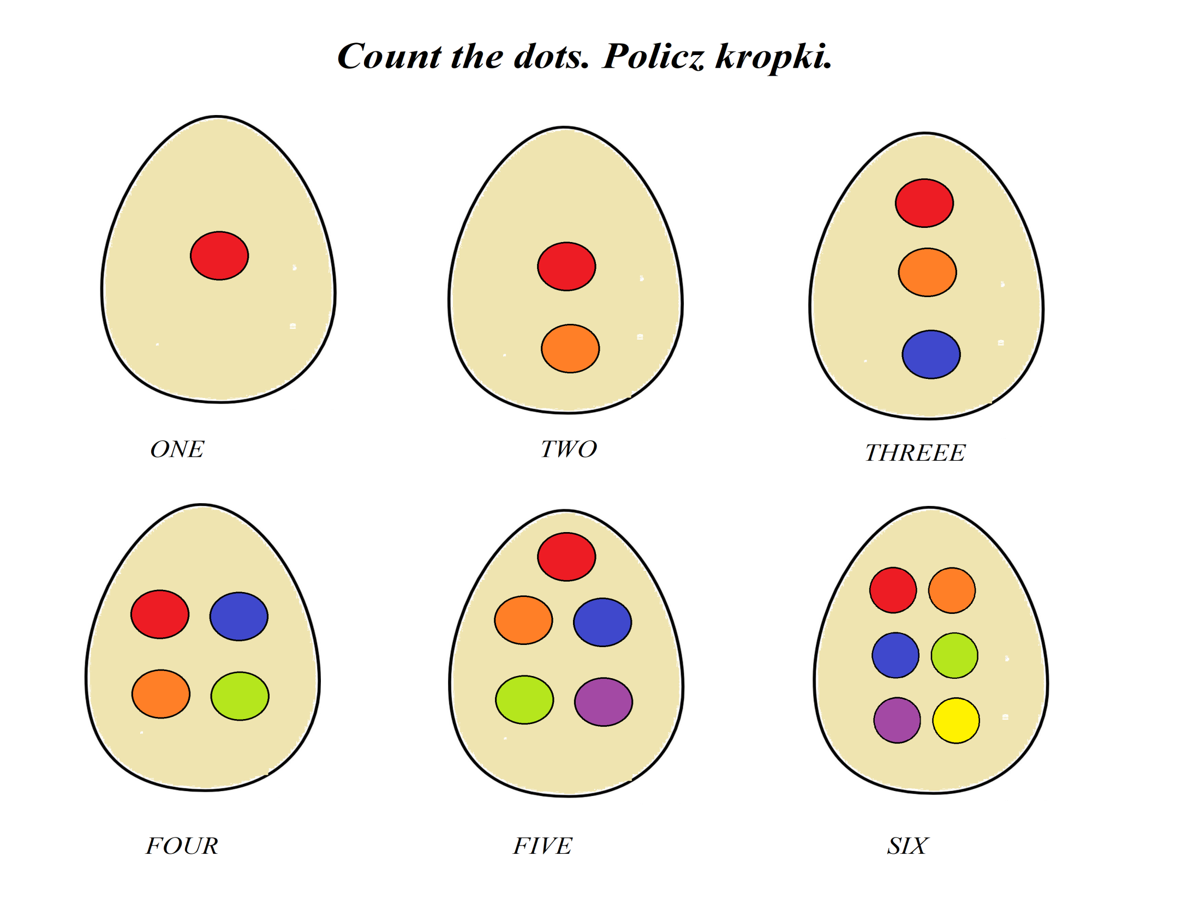

Slide 9
EASTER GREETINGS!
Warmest thoughts to you and your family on this holiday. Happy Easter!
Katarzyna Miętka

